Slide 1
ELBOW JOINT
BY
DR. OJEWALE A.O

Slide 2
OUTLINE
Intro’
Type
Articular surfaces
Ligaments
Bursae
Stability
Blood Supply
Movements
Applied Anatomy

Slide 3
Intro’
It is a joint between the lower end of the humerus and upper ends of the radius and ulna.
It actually includes two articulations:
Humero-ulnar articulation, between the trochlea of the humerus and trochlear notch of the ulna.
Humero-radial articulation, between the capitulum of the humerus and the head of radius.
The joint line of elbow is situated 2 cm below the line joining the two epicondyles of humerus on the surface.

Slide 4
Cont’d
The complexity of elbow joint is further increased by its continuity with superior radio-ulnar joint.
There are three articulations in the elbow region:
Humero-ulnar
Humero-radial
Superior (proximal) radio-ulnar.
These are called cubital articulations.

Slide 5
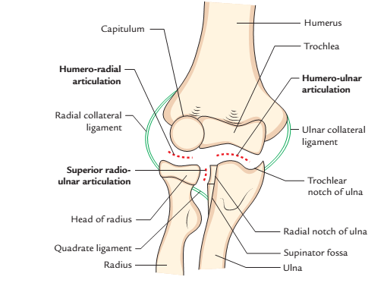
Cont’d
It is a hinge type of synovial joint

Slide 6
ARTICULAR SURFACES
The upper articular surface of the elbow joint is formed by the capitulum and the trochlea of the lower end of the humerus.
The lower articular surface of the elbow joint is formed by the upper surface of the head of the radius and trochlear notch of the ulna.
The capitulum is a rounded hemispherical eminence and possesses smooth articular surface only on its anterior and inferior aspects.

Slide 7
Cont’d
The trochlea is medial to capitulum and resembles a pulley. The medial flange of trochlea projects to a lower level than its lateral flange.
The trochlear notch of ulna is formed by the upper surface of the coronoid process and anterior surface of the olecranon process.
The upper end of radius is circular in outline and slightly depressed in the center.

Slide 8
LIGAMENTS
CAPSULAR LIGAMENT (JOINT CAPSULE)
It is a fibrous sac enclosing the joint cavity
The inner surface of the capsule is lined by the synovial membrane.

Slide 9
Attachment
Above, it is attached to the medial epicondyle, upper margins of radial, coronoid, and olecranon fossae, and lateral epicondyle of the humerus, i.e., it encloses all the non-articular fossae at the lower end of the humerus.
Below, it is attached to the anterior and medial margins of the coronoid process of ulna, upper margin of the annular ligament, and upper and medial margins of the olecranon process. Note, it is not attached to the radius.

Slide 10
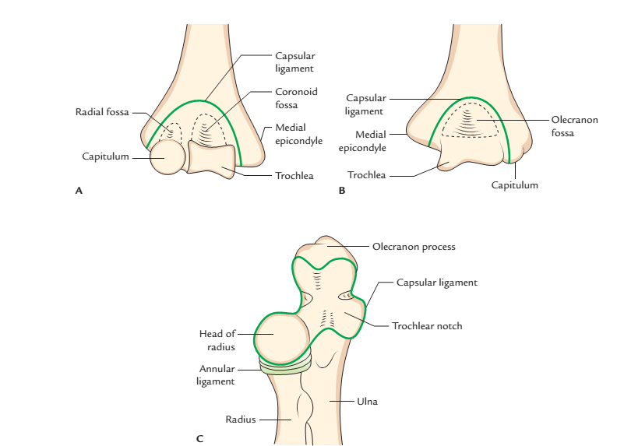
Attachment of capsular ligament of elbow joint: A, anterior aspect; B, posterior aspect;
C, anterosuperior aspect

Slide 11
Cont’d
To facilitate the movements of flexion and extension, the anterior and posterior aspects of the capsule are thinner than the sides. The inner surface of the joint capsule and non-articular bony parts inside the capsule are lined by synovial membrane.
The synovial membrane forms a crescentic fold between humero-radial and humero-ulnar parts, which contains an extrasynovial fat.

Slide 12
Cont’d
Between the synovial membrane and joint capsule, there are three other fat pads occupying olecranon, coronoid, and radial fossae.
The synovial membrane of elbow joint is continuous inferiorly with the synovial membrane of the superior radio-ulnar joint.

Slide 13
Cont’d
MEDIAL LIGAMENT
It is triangular in shape, with its apex attached to the medial epicondyle of the humerus and base to the coronoid and olecranon processes of the ulna.
It is divided into three bands: anterior, posterior, and inferior-united by a thin region.
The anterior band (strongest and stiffness) extends from front of the medial epicondyle of the humerus to a tubercle on the medial margin of the coronoid process.

Slide 14
Cont’d
The posterior band extends from back of the medial epicondyle of the humerus to the medial margin of the olecranon process.
The inferior band or oblique band extends between the olecranon and coronoid processes.
Between anterior and posterior bands, intermediate fibres descend from the medial epicondyle to the oblique band.

Slide 15
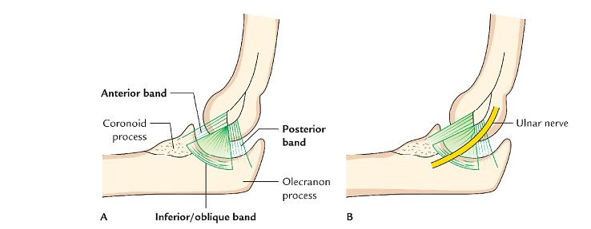
Cont’d
Attachments of ulnar collateral ligament of the elbow joint

Slide 16
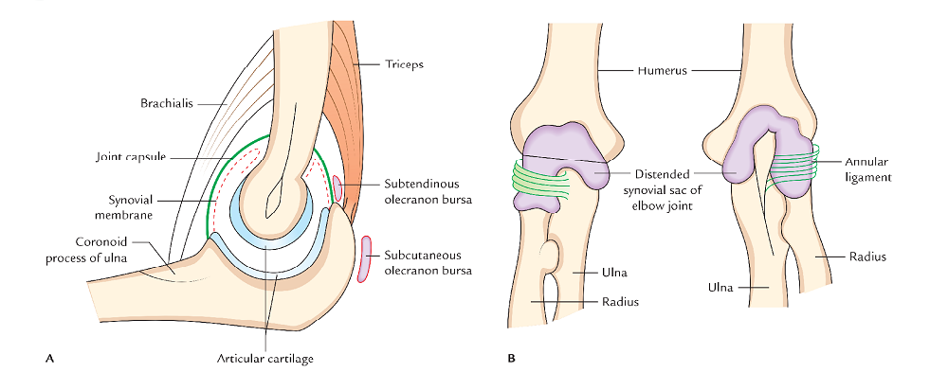
Cont’d
Elbow joint: A; Saggital section, B; Synovial sac (distended)

Slide 17
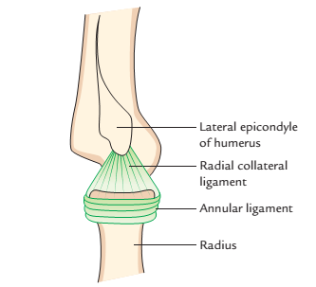
Cont’d
LATERAL LIGAMENT:
It extends from lateral epicondyle of the humerus to the annular ligament with which it blends.
RELATIONS
Anterior
Brachialis
Median nerve
Brachial artery
Tendon of biceps brachii. The last three structures are separated from the joint capsule by brachialis.

Slide 18
Cont’d
Posterior:
Tendon of triceps
Anconeus
Medially:
Flexor carpi ulnaris
Ulnar nerve (posteromedially)
Common flexor origin of the muscles of the forearm (anteromedially)
Laterally
Supinator,
Common extensor origin of the muscles of the forearm (posterolaterally)
Extensor carpi radialis brevis

Slide 19
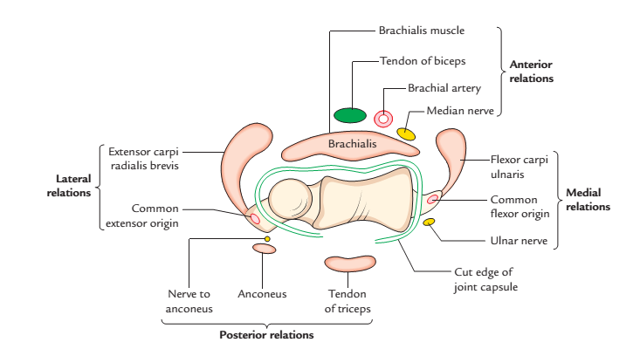
Cont’d
Relations of the elbow joint

Slide 20
BURSAE RELATED TO THE ELBOW JOINT
There are four important bursae are related to the elbow joints- two in relation to the triceps insertion and two in relation to the biceps insertion:
Subtendinous olecranon bursa, a small bursa between triceps tendon and upper surface of the olecranon process.
Subcutaneous olecranon bursa, a large bursa between skin and subcutaneous triangular area on the posterior surface of the olecranon.

Slide 21
Cont’d
Bicipitoradial bursa, a small bursa separating biceps tendon from smooth anterior part of the radial tuberosity.
A small bursa separating the biceps tendon from the oblique cord.

Slide 22
STABILITY OF THE ELBOW JOINT
It is quite stable due to the following two factors
Pulley-shaped trochlea of humerus fits properly into jaw-like trochlear notch of ulna.
Strong ulnar and radial collateral ligaments.

Slide 23
BLOOD (ARTERIAL) SUPPLY
It is by arterial anastomosis around the elbow formed by the branches of
Brachial artery [Profunda brachii artery (radial collateral artery, posterior descending artery and middle collateral artery), superior and inferior ulnar collateral arteries]
Ulnar artery (anterior and posterior ulnar recurrent arteries, a branch of common interosseous artery)
Radial artery (radial recurrent artery)

Slide 24
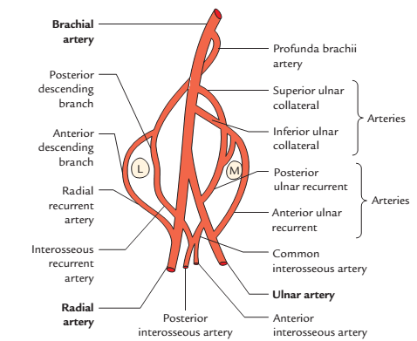
Arterial anastomosis around the elbow joint (L=lateral epicondyle, M=medial epicondyle).

Slide 25
NERVE SUPPLY
It is by articular branches from:
Radial nerve (through its branch to anconeus),
Musculocutaneous nerve (through its branch to brachialis),
Ulnar nerve
Median nerve.

Slide 26
MOVEMENTS OF THE ELBOW JOINT
Movements | Muscles producing movements
Flexion | • Brachialis • Biceps brachii • Brachioradialis
Extension | • Triceps • Anconeus

Slide 27
APPLIED ANATOMY
Elbow effusion: The distension of elbow joint due to effusion within its cavity occurs posteriorly because capsule of the joint is thin posteriorly and covering fascia is also thin. The joint is aspirated by inserting a needle on the posterolateral side, above the head of radius with elbow at the right angle.
Dislocation of elbow: Posterior dislocations of elbow are more common and are often associated with fracture of the coronoid process.

Slide 28
Cont’d
The dislocation invariably occurs by falling on an outstretched hand. The triangular relationship between the olecranon and the epicondyles of humerus is lost. Note, in normal flexed elbow, the tip of olecranon process and two epicondyles of humerus form an ‘equilateral triangle’
The reduction, if done early, is achieved fairly easily by first giving traction to overcome spasm and then flexing the forearm to lever joint back into the place.

Slide 29
Cont’d
Nursemaid’s elbow/pulled elbow (subluxation of head of radius) occurs in 1–3 years old (preschool children) when the forearm is suddenly pulled in pronation. The head of radius comes out of annular ligament and the elbow is kept slightly flexed and pronated. An attempt to supinate the forearm causes severe pain.
The reduction is easily achieved by supinating and extending the elbow and simultaneously applying direct pressure posteriorly on the head of radius.

Slide 30
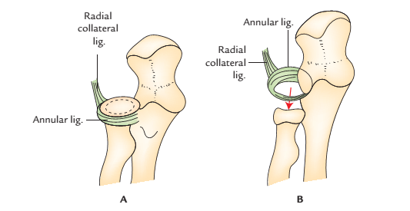
Cont’d
Pulled elbow: A, head of radius within cup-shaped annular ligament; B, head of radius displaced down from the annular ligament.

Slide 31
Cont’d
Tennis elbow: It is a clinical condition characterized by pain and tenderness over the lateral epicondyle of the humerus with pain during sudden pronation. It occurs due to:
sprain of lateral collateral ligament of elbow joint,
a tear of the fibres of extensor carpi radialis brevis,
an inflammation of bursa underneath the extensor carpi radialis brevis,
strain or tear of common extensor origin.

Slide 32
Cont’d
Golfer’s elbow: It is a clinical condition characterized by pain and tenderness over the medial epicondyle of the humerus. It occurs due to strain or tear of common flexor origin with subsequent inflammation of medial epicondyle, following repetitive use of superficial flexors of forearm as during playing golf.
Student’s elbow (Miner’s elbow) is characterized by a round oscillating painful swelling over the olecranon. It occurs due to inflammation of subcutaneous olecranon bursa lying over subcutaneous triangular area on the posterior aspect of the olecranon process.

Slide 33
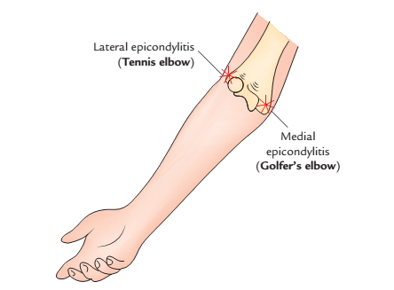
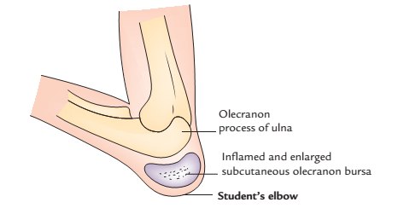
Cont’d
Lateral and medial epicondylitis
Student’s elbow (Miner’s elbow)

Slide 34
Cont’d
Nerve compressions around elbow:
The nerve entrapments around elbow are common and cause pain, muscle atrophy, and weakness in the area supplied by the entrapped nerve. The examples are:
Median nerve entrapment, Ulnar nerve entrapment and posterior interosseous nerve entrapment .

Slide 35


